Slide 1


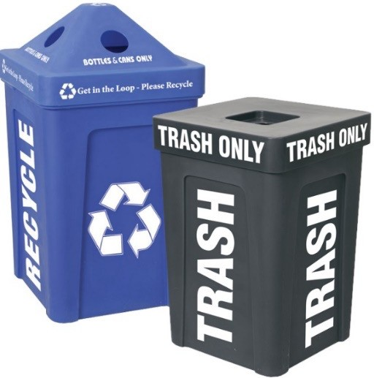
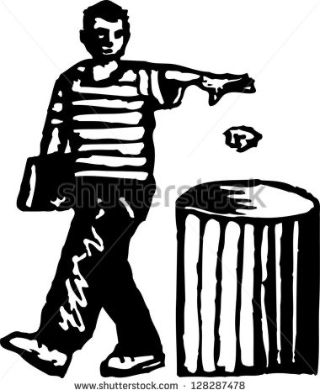
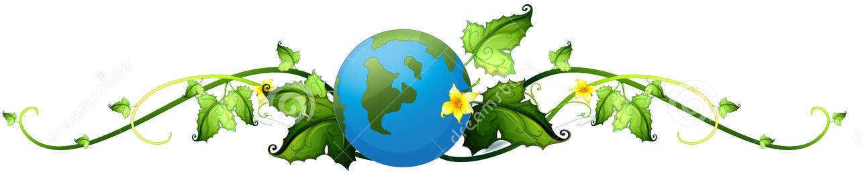
My Pledge to Planet Earth
I will not litter.
I promise to put trash and recyclables into proper containers. I will ask others to respect our planet and keep it litter-free.
I will protect our Planet Earth because it is irreplaceable!
Please put trash and recyclables into proper containers!
name
date
Toss it right…
please don’t litter!

